Slide 1
HAZARD COMMUNICATION -
HAZCOM
Sedgwick Risk Services
Presented by
Sedgwick on behalf of ORM
March 2020

Slide 2
Disclaimer
The information contained herein is not intended as legal advice, is advisory only; provided on an “as is” basis, and to be used solely at the user’s risk. The information is made available without any warranty of any kind and, to the extent allowed by law, Sedgwick disclaims any and all implied warranties and representations. All procedures and training, whether required by law or not, should be implemented and reviewed by safety and risk management professionals and legal counsel to ensure that all local, state, and federal requirements are satisfied. Sedgwick disclaims any and all liability that may arise in connection with a user’s use of this information.

Slide 3
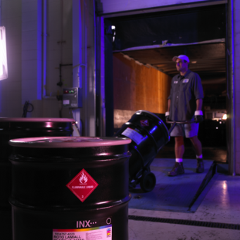
What is Hazard Communication?
2012 revisions align with the United Nation’s GLOBALLY
HARMONIZED
SYSTEM - GHS of Classification and Labeling of Chemicals

Slide 4
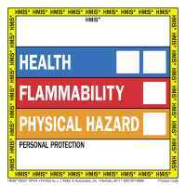
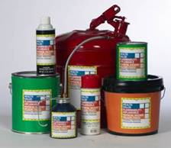

What is Hazard Communication?

Slide 5
“Employee’s Right to Know”
Employees working around hazardous chemicals have the “Right To Know” of possible dangers and how to protect themselves.
In addition, Stop Work Authority (SWA) gives employees the authority and responsibility to require that work be stopped when a dangerous condition is observed.

Slide 6
“I’ve been trained in HAZCOM. Why do I need it again?”
Refresher training :
  Upon initial assignment of employee to a new worksite or transfer from one work area to another where different hazards are present, if:
    A new chemical, procedure or work practice is introduced,
    Changes in the workplace render previous training obsolete, or
    The employee’s behavior or work shows that the previous training was not effective or retained sufficiently.

Slide 7
Comparison
“Original” HAZCOM
___________
Written Program
Chemical Inventory
MSDS’s
Labeling
Training
HAZCOM w/ GHS
___________
Written Program
Chemical Inventory
SDS’s
Labeling
Training
Mandatory Label Elements
Mandatory SDS Format
Pictograms

Slide 8
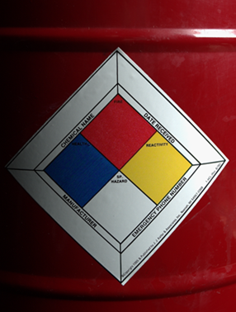
What is Hazard Communication?
  NFPA
  Health Hazards (blue)
  Flammability Hazards (red)
  Reactivity Hazards (yellow)
  Special Hazards (white)
  HMIS
  Health Hazards (blue)
  Flammability Hazards (red)
  Physical Hazards (orange)
  PPE (white)

Slide 9

Terminology
Action Level
Employee exposure to a dangerous situation, such as excessive noise, lead or hazardous materials, that required action by the employer to eliminate, reduce or control; calculated as an 8-hour time-weighted average.
Asphyxiant
A substance or mixture that displaces oxygen in the ambient atmosphere, and can thus cause oxygen deprivation in those who are exposed, leading to unconsciousness and death.
Carcinogenic
  A toxin that is capable of causing cancer.

Slide 10
Terminology
CHEMTREC
  A round-the-clock resource for obtaining immediate critical response information for incidents involving hazardous materials and dangerous goods; linked to the largest network of chemical and hazardous material experts in the world.
Combustible
Capable of catching fire and burning.

Slide 11
Terminology
Compressed Gas
A substance that is a gas at room temperature but is transported and used under pressure in cylinders at a pressure of 200kPa (29psi) or more, or which are liquefied or liquefied and refrigerated.
Flammable
Aerosol - yields a flame projection exceeding 18” at full valve opening, or a flashback at any degree of valve opening.
Gas - A gas that at ambient temperature and pressure, (A) forms a flammable mixture with air at a concentration of 13 % by volume or less, or (B) forms a range of flammable mixtures with air wider than 12 % by volume, regardless of the lower limits.
Liquid - Any liquid having a flashpoint below 100 degrees, except
any mixture having components with flashpoints of 100 degrees or
higher, the total of which make up 99 % of more of the total volume
of the mixture.

Slide 12
Terminology
Flammable (cont.)
(iv) Solid - a solid, other than a blasting agent or explosive that is liable to cause fire through friction, absorption of moisture, spontaneous chemical change, or retained heat from manufacturing or processing, or which can be ignited readily and when ignited burns so vigorously and persistently as to create a serious hazard.

Slide 13

Terminology
Flashback
When a flammable gas or vapor trail is ignited by a spark or ignition source and the flame travels back along the vapor trail; the source of the vapor may be an open or leaking container that could burst into flames or explode.
Flash Point
The lowest temperature at which the vapor of a substance will catch on fire, even momentarily, if heat is applied, or minimum temperature at which a liquid gives off enough vapor to burn when it contacts an open flame or spark. The flashpoint provides an indication of how flammable a substance is or is not and is not to be confused with ignition temperature; the lower the flashpoint of a liquid, the greater the risk of fire.

Slide 14

Terminology
IDLH
  Immediately Dangerous to Life and Health
Irritant
  A biological, chemical, or physical agent that stimulates a characteristic function or elicits a response, esp. an inflammatory response.
MSDS / SDS
Material Safety Data Sheet / Safety Data Sheet

Slide 15

Terminology
Lower / Upper Flammability Limit
The amounts of vapor in air which form explosive mixtures; the range of vapor concentrations in air, which explode if heat is added.
Lower/Upper Explosive Limit
The amounts of vapor in air which form flammable mixtures that will catch on fire and continue to burn. The lower the ignition temperature, the more likely the substance is going to be a fire hazard.

Slide 16

Terminology
Mutagenic
  A toxin that may be capable of causing mutations, or damage, to genetic material. Damage to genetic material is thought to be one of the steps in causing cancer or birth defects.
NFPA
  National Fire Protection Association
Odor Threshold
  The lowest concentration of a substance's vapor, in air, that can be smelled. Odor thresholds are highly variable depending on the individual who breathes the substance and the nature of the substance.

Slide 17
Terminology
Permissible Exposure Limits – PEL
  The limits for airborne concentrations of a material or chemical under which it is believed that nearly all workers may be repeatedly exposed day after day, for a working lifetime, without harmful effects.
  Threshold Limit Values (TLV)
    TWA - Time-Weighted Average; the average exposure to a contaminant or condition (such as noise) to which workers may be exposed without adverse effect over a period such as in an 8-hour day or 40-hour week.
    STEL - Short-Term Exposure Limit; The maximum amount of harmful chemical to which a person may be exposed without being physically harmed; not to exceed 15 minutes per exposure and not more than 4 times per 8-hour shift.
    Ceiling - The airborne concentration of a chemical that should not be
    exceeded during any part of the working exposure.

Slide 18

Terminology
pH
A rating scale of how corrosive a material or chemical is which runs from 0 (extremely strong acid) to 14 (extremely strong base).
Physical Hazard
A chemical scientifically classified as a combustible liquid, a compressed gas, an organic peroxide, an oxidizer, pyrophoric, unstable, water-reactive, flammable or explosive.
Pictogram
A composition that may include a symbol plus other graphic elements, such as a border, background pattern, or color, that is intended to convey specific information about the hazards of a chemical.

Slide 19

Terminology
ppm
parts per million
Pyrophoric
A chemical that will ignite spontaneously in air at a temperature of 130 degrees F or below.
Reactivity
The chemical reactions of 2 or more substances when they come into contact with each other. Of particular concern are chemicals that react with water, air or oxygen.

Slide 20
Terminology
Relative Density
The ratio of the density of a substance to the density of a given reference material.
RTECS
Registry of Toxic Effects of Chemical Substances.
Sensitizer
A substance or chemical that may cause a person to become increasingly sensitive to a material after each exposure; eventually, exposure to only small amounts of material may produce an allergic-type reaction of the skin or respiratory tract.

Slide 21
Terminology
Specific Gravity
A measure of how many times lighter or heavier a liquid or solid is when compared to water, which has a specific gravity of 1.
If the specific gravity of the material is less than 1, the material will float on water; if it is greater than 1, it will sink. This helps to predict how a chemical will behave if it spills or leaks.
Also, if a chemical catches fire, but its specific gravity shows it floats on water, than water cannot be used to extinguish the blaze and is more likely to spread the fire than put it out.

Slide 22
Terminology
Toxicity
The degree to which a substance is toxic or poisonous.
Vapor
The gas given off by a solid or liquid substance at ordinary temperatures.
Volatility
The degree of how easily a chemical or substance changes from liquid to vapor at normal temperatures and pressures.

Slide 23
Hazard and Risk
What’s the difference?

Slide 24
Hazard and Risk with Toxic Chemicals
Conditions
a. Stored correctly
b. Completely
sealed
c. Not handled
Conditions
a. Stored correctly
b. Seal broken,
toxic vapors
escaping
c. Unprotected
worker
Conditions
a. Stored correctly
Seal broken, toxic
Vapors escaping
c. protected worker
Exposure = Zero
Hazard = High
Risk = Zero
Exposure = High
Hazard = High
Risk = High
Exposure = Low
Hazard = High
Risk = Low

Slide 25
GHS has 3 Broad Categories of Hazards:
  Health Hazards
  Physical Hazards
  Environmental Hazards

Slide 26

Health Hazards
Acute vs. Chronic
Aspiration
Skin Corrosion or Irritation
Serious Eye Damage or Irritation
Respiratory or Skin Sensitization
Germ Cell Mutagenicity
Carcinogenicity
Reproductive Toxicity
Target Organ Systemic Toxicity
Single Exposure
Repeated Exposure

Slide 27
Physical Hazards
Explosives
Flammable Liquids, Gases, Solids, or Aerosols
Oxidizing Liquids, Gases, or Solids
Self-Reactive Substances
Pyrophoric Liquids or Solids
Self-Heating Substances
Substances, which on contact with water, emit flammable gases
Substances Corrosive to a Metal
Gases Under Pressure

Slide 28

Environmental Hazards
Hazardous to the Aquatic Environment
  Acute Aquatic Toxicity
  Chronic Aquatic Toxicity
    Bioaccumulation Potential
    Rapid Degradability
Hazardous to the Ozone Layer
Hazardous to Wildlife or Plants

Slide 29

HAZCOM Written Program
Must include:
  A List of Hazardous Chemicals Present in the Workplace
  SDSs
  Labeling System

Slide 30

HAZCOM Written Program
Must include:
  Employee Training
  Information Regarding
  Non-Routine Hazards
  Methods of Informing
  Employers of Other
  Workers

Slide 31

HAZCOM Written Program
Required to be available to workers upon request.
Does not have to be accessible to every work area and every work shift.
HAZCOM

Slide 32
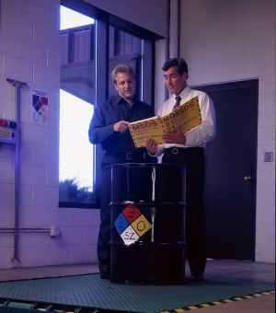
Accessing HAZCOM Documents
Workers must know the location of and how to obtain:
  The Written HAZCOM Program
  Lists of Hazardous Chemicals
  SDSs

Slide 33
Routes of Entry
Inhalation
Absorption
Ingestion
Injection

Slide 34
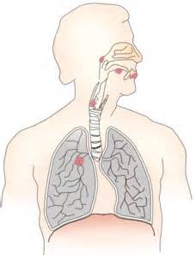
Inhalation
Acute Effects:
  Immediate Irritation or Burning of Nose, Throat or Lungs, Dizziness, Headache, Loss of Consciousness *
Chronic Effects:
  Respiratory Illnesses, Cancer.
  Once Inside the Body, May Circulate in the Bloodstream & Cause Other Systemic Conditions *
* NOTE - Not all chemicals cause the effects listed. Refer to the chemical SDS for more specific information.

Slide 35

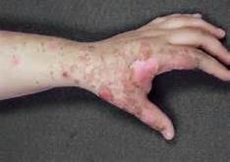
Absorption
Acute Effects:
  Immediate Irritation, Burns, Blisters, Open Wounds to Skin or Eyes, Itchy/Flaky Skin, Temporary Loss of Vision
Chronic Effects:
  Contact Dermatitis (Sensitivity), Blindness, Cancer.
  Once Absorbed Through Skin, May be Transported by Bloodstream to Target Organs & Cause Other Systemic Conditions

Slide 36


Ingestion
Acute Effects:
Immediate Irritation to the Mouth, Throat or Digestive Tract; Nausea, Stomach Pain; Breathing Difficulties; Dizziness.
Chemicals may also enter lungs during swallowing or vomiting.
Chronic Effects:
Cancer; Permanent Damage to Digestive Tract; Once Absorbed Through Stomach or Intestine Lining, may be Transported by Bloodstream to Target Organs & Cause Other Systemic Conditions

Slide 37
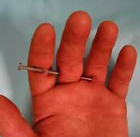

Injection
Acute Effects:
  Most Common; Chemical has Immediate Access into Bloodstream; Effects Similar to Absorption
Chronic Effects:
  Least Common; May be Transported by Bloodstream to Target Organs & Cause Systemic Conditions; Effects Similar to Absorption

Slide 38
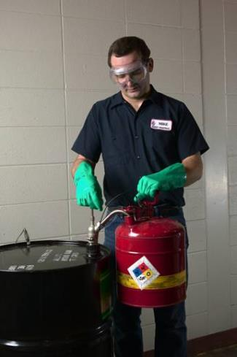
Protective Measures
Hierarchy of Controls:
  Engineering Controls
  Work Practices / Administrative Controls
  Personal Protective
  Equipment - PPE

Slide 39


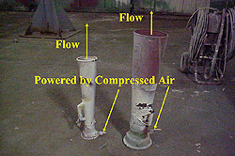
Workplace Controls
Engineering Controls
Preferred Method
_____________
Ventilation - Most Common

Slide 40

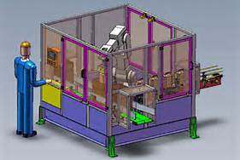
Workplace Controls
Engineering Controls
Preferred Method
_____________
Enclosures, Robotics

Slide 41

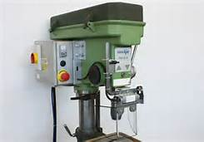
Workplace Controls
Engineering Controls
Preferred Method
_____________
Machine Guards, Enclosures

Slide 42
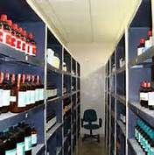

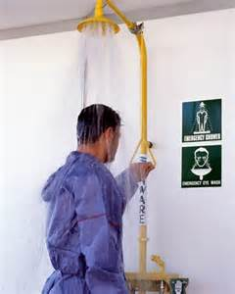
Workplace Controls
Administrative Controls:
Good housekeeping; safe work practices
Know where eyewash stations & safety showers are
& the log on JSAs.

Slide 43



Workplace Controls
Administrative Controls:
Safe Work Practices Such as Hand Washing Policies and No Eating/Drinking/Smoking in Work Areas; Separate Washrooms/Lunchrooms From Work Areas

Slide 44


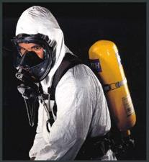
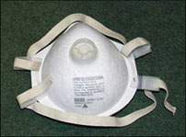
Workplace Controls
Administrative Controls
PPE

Slide 45



Workplace Controls
Administrative Controls:
Training; Safe Work Practices Such as “Cut Away From, Not Towards”; Right Tool for Job
PPE

Slide 46




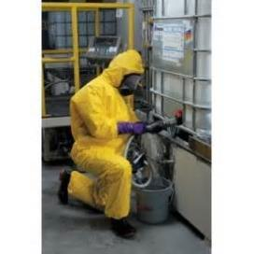

Workplace Controls
PPE

Slide 47


Safety Data Sheet (SDS)
Provided By: *
chemical manufacturers
distributors
importers
Includes Mandatory Chemical Information
Must be Readily Available to all Employees

Slide 48
Standardizing Safety Data Sheet (under GHS)
  Simplifies Employee Training
  Makes it easier for users to locate and understand
  the information they are seeking
  Improves the utility of SDSs
  Improves the accuracy of the information
  Segregates technical sections of the document
  from more basic elements
  Facilitates computerized information retrieval

Slide 49
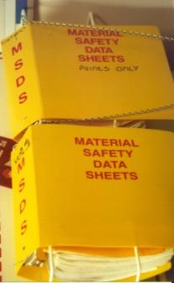
Safety Data Sheets
Section 1 - Identification
Section 2 - Hazards Identification
Section 3 - Composition/ Information on Ingredients
Section 4 - First Aid Measures
Section 5 - Fire-fighting Measures

Slide 50

Safety Data Sheets
Section 6 - Accidental Release
Measures
Section 7 - Handling and Storage
Section 8 - Exposure Controls /
Personal Protection
Section 9 - Physical / Chemical
Properties

Slide 51
Safety Data Sheets
Section 10 - Stability & Reactivity
Section 11 - Toxicological Information
  Section 12 - Ecological Information *
  Section 13 - Disposal Considerations *
  Section 14 - Transport Information *
  Section 15 - Regulatory Information *
Section 16 - Other Information

Slide 52
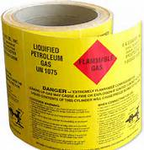
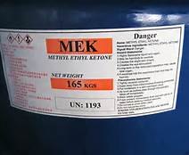
Labeling
Serve as an Immediate Warning
Warn of Potential Dangers
Not intended to be the sole source of information

Slide 53
Labeling Categories
Before a product can be labeled under GHS, it must be classified into one of 28 types of hazards:
Acute Toxicity – Inhalation
Acute Toxicity – Dermal
Acute Toxicity – Oral
Aspiration Hazard
Carcinogenicity
Corrosive to Metals
Explosives
Eye Damage/Irritation
Flammable Aerosols
Flammable Gases
Flammable Liquids
Flammable Solids
Gases Under Pressure
Germ Cell Mutagenicity
Organic Peroxides
Oxidizing Gases

Slide 54
Labeling Categories
Before a product can be labeled under GHS, it must
be classified into one of 28 types of hazards: (cont’d)
Oxidizing Liquids
Oxidizing Solids
Pyrophoric Liquids
Pyrophoric solids
Self-heating Substances and
Mixtures
Sensitization – Respiratory
Sensitization – Skin
Skin Corrosion/Irritation
Specific Target Organ Toxicity (repeated exposure)
Specific Target Organ Toxicity
(single exposure)
Substances and mixtures
which, in contact with
water, emit flammable
gases
Toxic to Reproduction

Slide 55
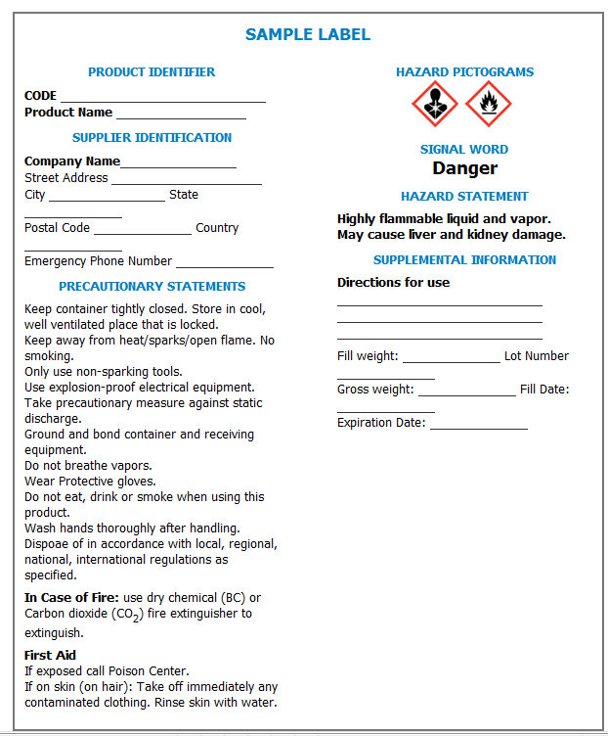

Slide 56
Labeling Elements (Appendix C)
PRODUCT IDENTIFIER:
A product identifier (name) used on a “GHS” label should match the product identifier used on the “SDS”.
The product identifier lists the chemical identity of the hazardous substance.

Slide 57
Labeling Elements (Appendix C)
SUPPLIER IDENTIFICATION:
The name, address and telephone number of the manufacturer or supplier of the product must be provided on the label.

Slide 58
Labeling Elements (Appendix C)
Pictograms:
Quickly convey specific information
Make warnings more noticeable and easier for employees to understand.
The specific pictograms that are required on a particular label are determined by the hazard classification.
Labels may not have blank
(unfilled) squares.

Slide 59
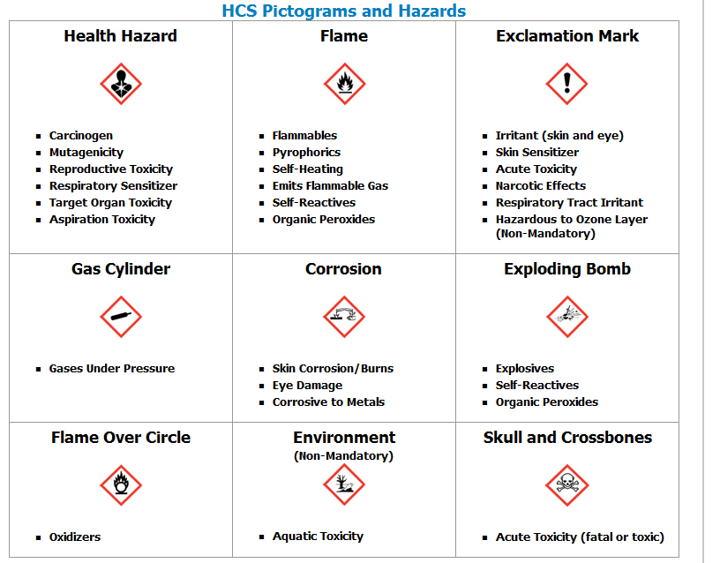
Labeling Elements

Slide 60
Labeling Elements (Appendix C)
Signal Word:
One of these two signal words must appear on labels:
DANGER: for the more severe hazard categories
WARNING: for less serious hazards
The appropriate signal word is chosen from the chart in “Appendix C”.
Note: if the word “DANGER” appears on the label, the word “WARNING” will not appear.

Slide 61
Labeling Elements (Appendix C)
Hazard Statements:
Based on the hazard classification
of the chemical
Describes the hazard associated
with the chemical
A statement should be present for
each type of hazard
Multiple, similar statements may
be combined.
Hazard statements are specified
from “Appendix C”

Slide 62
Labeling Elements (Appendix C)
Precautionary Statements:
Based on the hazard classification of the chemical
Describes recommended measures that should be taken to protect against hazardous exposures, or improper storage or handling of a Chemical
Includes first aid procedures

Slide 63
Labeling Elements (Appendix C)
Supplementary Information:
Additional information provided at the discretion of the manufacturer
“GHS” provides guidance to ensure that supplemental information does not lead to wide variation in information or contradict or undermine the “GHS” information.

Slide 64
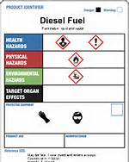
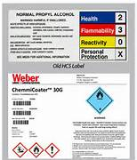
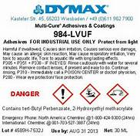
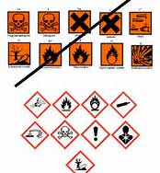
Labeling Elements (Appendix C)

Slide 65
GHS
vs.
HMIS
What is the difference between GHS and HMIS Hazard Categories?
GHS Hazard Category is a numerical system, ranking hazards based on their severity- Hazard Category of 1 is more severe than a 4.
HMIS Chemical Hazard Rating System is inverted – 0 is the least severe and 4 is the most severe.
Many workers may not be affected, as the Hazard Category will NOT be found on the new label.

Slide 66
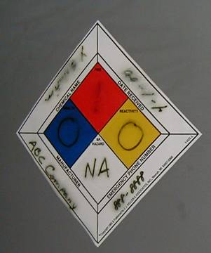
Labeling
Replace Labels That Come Off, Become Smudged or Unreadable
For Hard-to-Label Containers,
Use:
Signs or Placards
Process Sheets, or
Batch Tickets

Slide 67
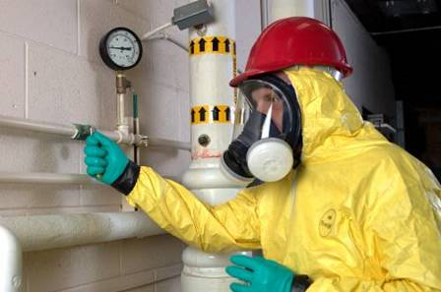
Hazards of Non-Routine Tasks
Know what chemicals you work with and their hazards
Know the contents of pipes

Slide 68
Summary
________________________
5 Mandatory Program Elements Have NOT Changed.
Written Program
Chemical Inventory
MSDS -> SDS
Labeling
Training
GHS Changes Incorporate:
Standardizing SDSs
New Label Requirements
Pictograms

Slide 69
Thank you | questions

